Slide 1
Scrum Training

Slide 2
Objectives
Provide an overview of Agile delivery and Scrum
Introduce you to Scrum roles, responsibilities and processes for software delivery
Interactive session to give you the theory and techniques to take back to your team

Slide 3
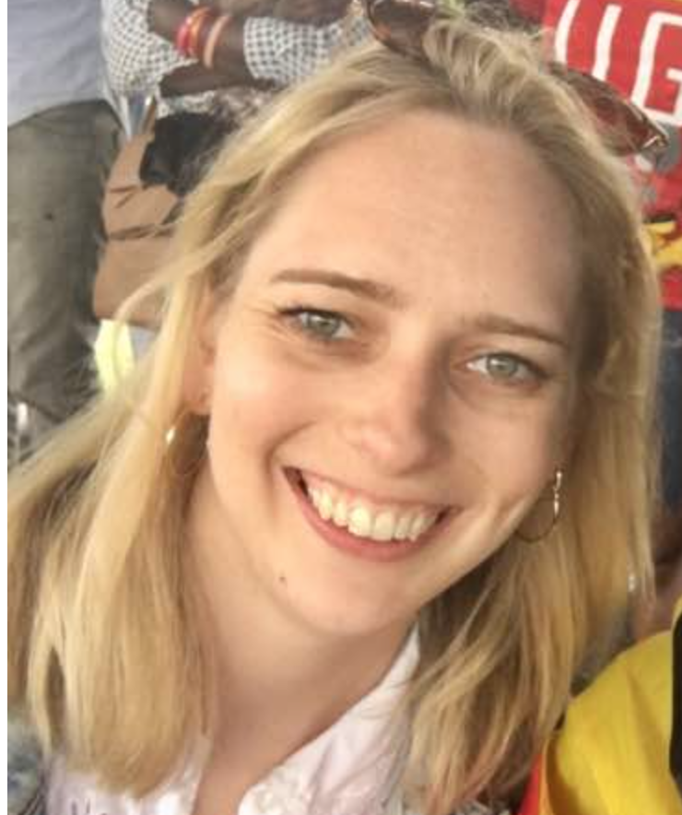



Introducing your trainers...
Notes:
Each speaker introduces themselves and says one line on while agile is important to them

Slide 4
It’s a packed agenda!
Objectives
Introduction to Agile
A Brief History of Agile
Agile Manifesto and Principles
Scrum Roles
Scrum Ceremonies
Scrum Cycle
Scrum Artefacts
Roadmap and Release plan
Wrap up
Tea Break
10.45 - 11 am
Lunch
1 - 2pm
Tea Break
3.45 - 4pm
Notes:
But don’t worry, we’ve planned for breaks
Grab a tea or coffee @ 10.45
Lunch has been ordered for 1 - 2pm - we’ve catered for carnivores and herbivores accordinly!
And we’ll have another short break around 3.45pm

Slide 5
Ball Point Game
Split into two teams!
The goal of your team is to collect as many ball points as possible in 1 minute.
A ball point is scored by a team when a ball is touched by every team member once.
But!
Start point = End point
Ball must have air time, no hand to hand pass
No passing to the direct neighbour
If a ball falls on the floor, start again
Notes:
Grace & alice
Create a flip chart with the “scoreboard” for the game. Write the rules on a flip chart or white board.
How to facilitate?
2 min introduction
2 min for rules
2 min preparation time for first sprint
Run 5 iterations:
– Get an estimate from the team
– 2 min iteration
– 1 min team to plan improvements
10 minute debrief - what were people’s observations? What did you learn?
http://dpwhelan.com/blog/uncategorized/learning-scrum-through-the-ball-point-game/

Slide 6
Ball Point Game
Ok how did you all do?
Let’s play again but this time you have 2 minutes to plan your strategy as a team.
At the end of the round we will count how many ball points were scored.
Notes:
Grace & alice
Create a flip chart with the “scoreboard” for the game. Write the rules on a flip chart or white board.
How to facilitate?
2 min introduction
2 min for rules
2 min preparation time for first sprint
Run 5 iterations:
– Get an estimate from the team
– 2 min iteration
– 1 min team to plan improvements
10 minute debrief - what were people’s observations? What did you learn?
http://dpwhelan.com/blog/uncategorized/learning-scrum-through-the-ball-point-game/

Slide 7
Ball Point Game
Ok how was that round?
We’ll give y0u another 2 minutes to perfect your strategy before we play again….
Notes:
Alice: So what was the point of this? What did we learn?
Grace: Key message: Through continually inspecting and adapting our processes we can improve our velocity and efficiency
Create a flip chart with the “scoreboard” for the game. Write the rules on a flip chart or white board.
How to facilitate?
2 min introduction
2 min for rules
2 min preparation time for first sprint
Run 5 iterations:
– Get an estimate from the team
– 2 min iteration
– 1 min team to plan improvements
10 minute debrief - what were people’s observations? What did you learn?
http://dpwhelan.com/blog/uncategorized/learning-scrum-through-the-ball-point-game/

Slide 8
Introduction to Agile

Slide 9

AGILE
Scrum
Lean Software Development
Kanban
XP (Extreme Programming)
Crystal Clear
….
CI (Continuous Integration)
CD (Continuous Deployment)
FDD (Feature Driven Development)
TDD (Test Driven Development)
...
Notes:
What is your understadnging of Agile>?
Agile Development” is an umbrella term for several iterative and incremental software development methodologies. The most popular agile methodologies include Extreme Programming (XP), Scrum, Crystal, Dynamic Systems Development Method (DSDM), Lean Development, and Feature-Driven Development (FDD).
While each of the agile methodologies is unique in its specific approach, they all share a common vision and core values (see the Agile Manifesto).
They all fundamentally incorporate iteration and the continuous feedback that it provides to successively refine and deliver a software system.
They all involve continuous planning, continuous testing, continuous integration, and other forms of continuous evolution of both the project and the software.
They are all lightweight, especially compared to traditional waterfall-style processes, and inherently adaptable.
The important part about agile methods is that they all focus on empowering people to collaborate and make decisions together quickly and effectively.

Slide 10
Agile Software Development
Based on the concept of iterative development
Collaboration - Key ingredient which refines requirements and solutions between self-organizing cross-functional teams
A disciplined project management process that encourages frequent inspection and adaptation
A leadership philosophy that encourages teamwork, self-organization and accountability
A set of engineering best practices intended to allow for rapid delivery of high-quality software
A business approach that aligns development with customer needs and company goals
Notes:
Does anyone have any questions ? Or want to elaborate on any of those points?

Slide 11
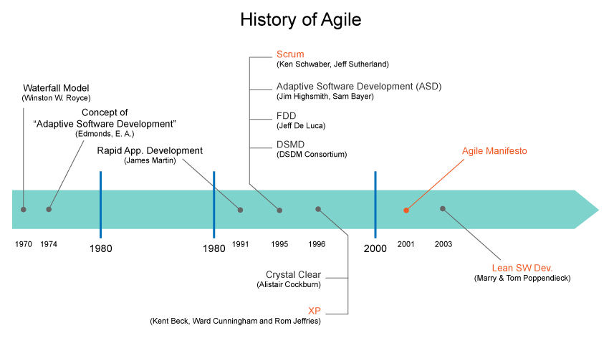
History of Agile
Notes:
Although the roots of Agile may go back to the 50's Test Driven Development with Project Mercury, things really began to pickup in the early 90's with James Martin's RAD (Rapid Application Development). Then things picked up in the mid-90's with the advent of RUP (Rational Unified Process) and Scrum, followed by XP (Extreme Programming) in the late 90's. but the real watershed moment for the Agile movement was the publication of The Manifesto for Agile Software Development in 2001 by a group of 17 software developers, who met to discuss the collection of lightweight development methods, which is now referred to as Agile methods.
1974 - An adaptive software development process documented
1991 - "Rapid Application Development" published
1995 - DSDM Framework published
1995 - SCRUM presented at OOPSLA
1996 - XP Practices developed on C3 project
1997 - FDD processes designed by Jeff De Luca
1999 - FDD described in "Java Modeling in Color with UML"
1999 - "Extreme Programming Explained" published
1999 - "Adaptive Software Development" published
2001 - Crystal Light methodologies described in Cutter IT Journal,
2001 - Agile Manifesto written
2003 - "Lean Software Development: An Agile Toolkit for Software Development Managers" published

Slide 12
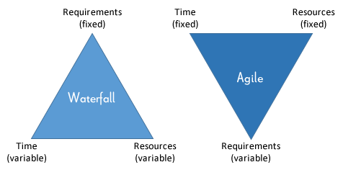
Waterfall vs Agile
Notes:
Typically in plan driven model, scope is fixed and the cost and schedule are variables. Many large scale software projects were and continued to be implemented this way. In many instances, when a particular scope is desired within a giving time-frame (fixing the schedule), plan driven projects add resources. But as we know simply adding resources to a project doesn't always bring about the desired goals.
As a matter of fact, if resources are added late on a software project, it actually has an adverse effect. This was indeed observed by Fred Brooks in his book The Mythical Man Month, also known as Brooks' Law: "adding manpower to a late software project makes it later".
With Agile software development, the triangle gets inverted - where cost and schedules are fixed and the scope is variable.

Slide 13
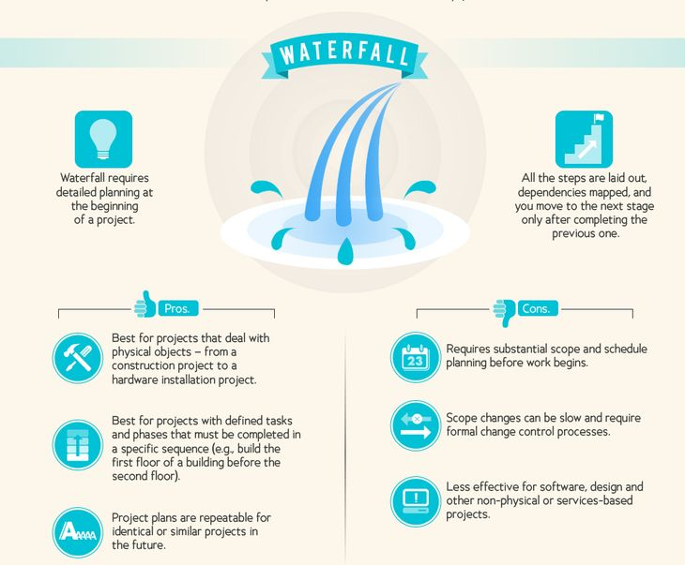
Waterfall

Slide 14
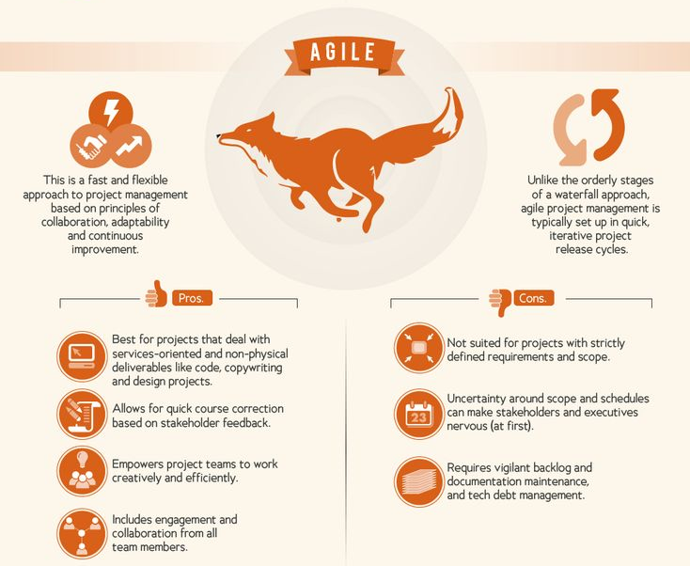
Agile

Slide 15
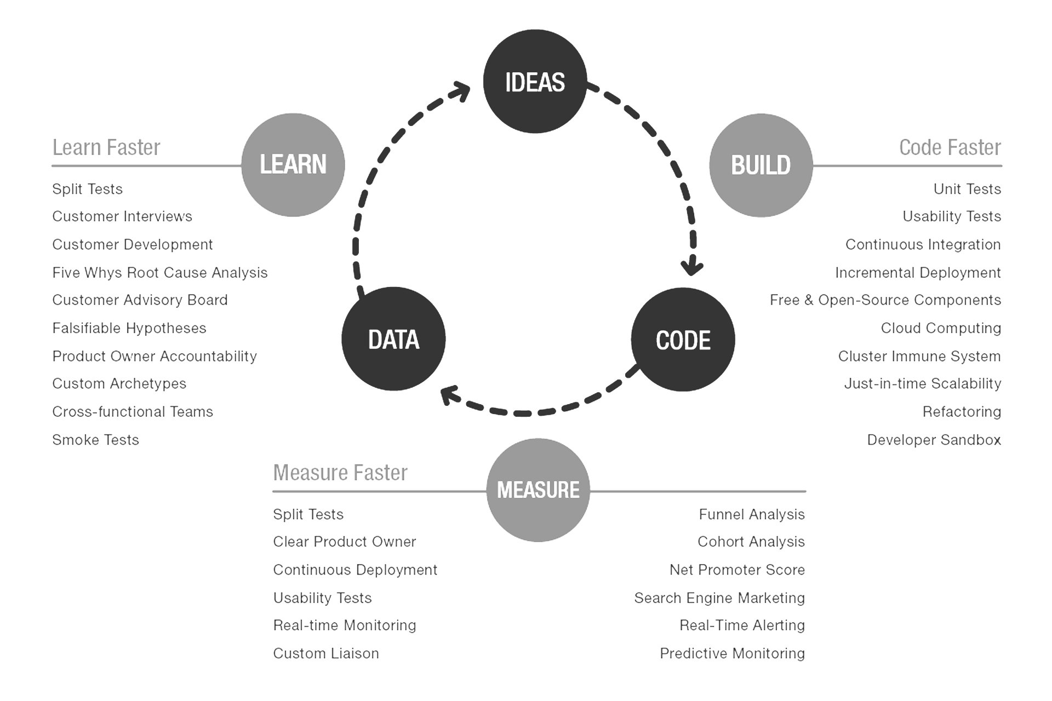
MVP
“MVP is the fastest way to get through the Build –Measure – Learn feedback loop with the minimum amount of effort.”
Eric Ries, The Lean Start-up
Notes:
Sameer
Did you know that the Copy past function on the iPhone was only released in IOS 3?
People weren’t put off buying, and advocating the iPhone because it wasn’t there.
When developing a product, you must always be thinking about the MVP and Min Marketable Feature Set
•Customers don’t know what you haven’t delivered •Quick to market and early feedback
•Find the point where…If the feature is any smaller it wouldn’t be marketable
In order to create a product, it’s necessary to look into the future and anticipate how the product will function and what it will do. However, what’s the problem with looking into the future? It’s notoriously difficult and often our assumptions can be incorrect. The only thing certain about the future is that it is uncertain.
Investing in a new product involves risk around the following areas:
- Targeting the wrong market segment
Building an app that’s not wanted or outdated by the time it gets to market
Is the functionality within the app wanted by customers?
This is a risk reduction tool to allow for the product to be released early to customers with minimal cost ensuring that only the most important features are included in the first release.
Therefore, when developing an agile application, it’s possible to have the following items:
Minimum viable product – serves as a tool which allows customers to test the product as it is developed
Minimum marketable product - A product that is complete enough for general release
As the agile process relies on feedback, throughout the stages of having both a MVP and MMP, there should be a feedback loop with customers, ensuring that bugs and requests that are identified are prioritised into the product backlog for the team to sprint on.
You are not wasting time and money of features customers don’t need and won’t use.

Slide 16
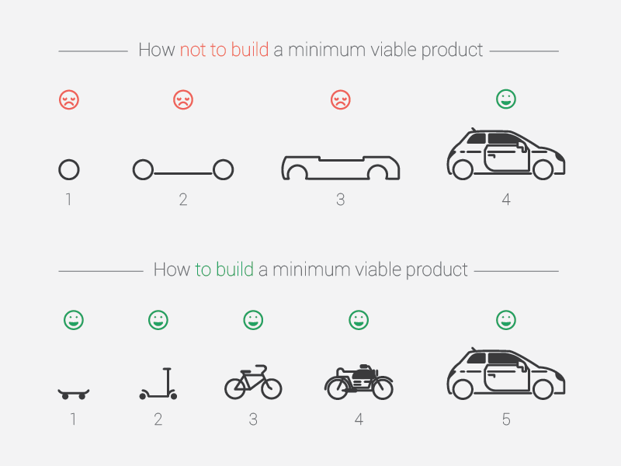
MVP
Notes:
A core part of Agile development is the concept of MVPs….
A minimum viable product (MVP) is a version of your product that has just enough features for you to test it with users and check whether those features work. Your MVP doesn’t have to be perfect. You always want to build a minimum of what you need in order to measure how people are going to use it. It saves resources and time, as the MVP helps you build a product that is more likely to succeed in the marketplace.

Slide 17
Agile - Key Participants
Vendors
Stakeholders
Development Team
Product Delivery
Scrum Master
Product Owner
Notes:
Stakeholders:
Stakeholders gets more responsive team.
Team delivers high value features sooner with small feedback cycle.
Reduced time to market time.
Vendors:
Reduced wastage.
Focus on development of high-value features.
Improved customer satisfaction.
Development Team:
Teams enjoys their work.
Active participation in all SDLC events.
Product Managers:
Makes their job of aligning business priorities with development team effort easier.
Project Manager / Scrum Master:
Better Project planning & tracking.
Burn-down charts, scrum artefacts display teams contributions.

Slide 18
Game: Agile Fact or Myth
Notes:
Kevin & Alice
It’s now time for another game - we’ll see how much you’ve learnt so far.
It’s a simple game - you have the opportunity to win points for your team!
We will show you a statement on the screen and you have to tell us if its true or false!

Slide 19
Agile is an adhoc methodology for delivery software
Notes:
False

Slide 20
Agile is more iterative than Waterfall delivery
Notes:
True

Slide 21
Agile works for projects with a fixed deadline
Notes:
True

Slide 22
User stories should always be the same size
Notes:
False

Slide 23
Agile is anti-architecture and anti-security
Notes:
False

Slide 24
Agile is scalable
Notes:
true

Slide 25
Agile means more meetings
Notes:
False - agile means more conversartion and collaboration not more meetings

Slide 26
Agile means no planning
Notes:
False

Slide 27
Agile focuses on quality and speed of delivery
Notes:
True

Slide 28
Agile means no documentation
Notes:
False

Slide 29
Stories have to finish inside a sprint
Notes:
True and False - Scrum

Slide 30
Agile = Scrum
Notes:
False

Slide 31
Agile works outside of software development
Notes:
True

Slide 32
Agile Manifesto & Principles

Slide 33
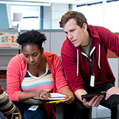

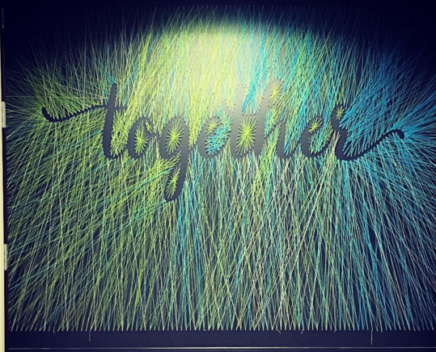

Agile Manifesto
There are 4 key values which are the foundation for agile ways of working.
INDIVIDUALS & INTERACTIONS
Over Processes and Tools
WORKING SOFTWARE
Over comprehensive documentation.
CUSTOMER COLLABORATION
Over contract negotiation
RESPONDING TO CHANGE
Over following a plan
Notes:
Alice
There are 4 key values which underpin the Agile Manifesto.
People deliver solution not process and tools.To provide this solutions both the product team and developers must work together daily throughout the project. It’s not that processes are not helpful. But ultimately if there is a capability issue it will not be solved by implementing a checklist=klok
Ol okloi09o9 h=-
Customers value more getting to experience the software than reading about the software. Getting a product into the customers hand creates an opportunity for learning and making adjustments.Working software is the primary measure of success.
Customers, stakeholders and team members collaborate with each other to find the best way to build and deliver the software. This is not about working in isolation or according to a previously defined written contract.
4. In our technology is moving fast. It’s not possible for companies to remain stagnant and survive. Therefore in order to keep up with changing customer needs we need to be able to change direction if required.

Slide 34
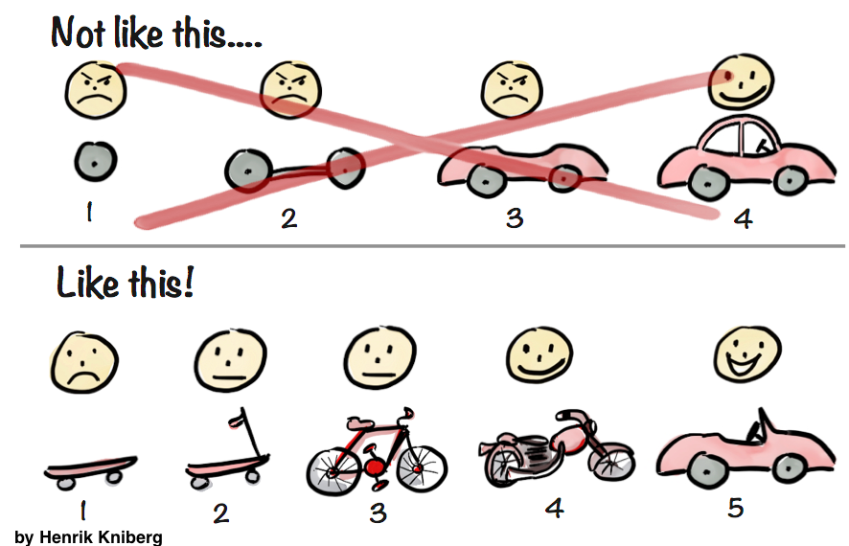
EARLY AND CONTINUOUS DELIVERY OF VALUABLE SOFTWARE
Customers are satisfied when there is:
Early delivery of products to customer for testing and feedback
Continuous delivery to let customers know the progress
Delivery of values to the customers by fulfilling the top priority requirements first
The output of each iteration is working code that can be used to evaluate and respond to changing and evolving user requirements.
Notes:
Grace’s section
Principles behind the Agile Manifesto

Slide 35

WELCOME CHANGE
As well as welcoming change there needs to be responsiveness to change
You can implement changes now -- you don’t need to wait for the next system to be built or a system redesign
Shorten the distance between conceiving and implementing an important change. And even if it’s late in the development process, don’t be afraid to make a shift.
This enhances competitive advantage to emerging opportunities

Slide 36
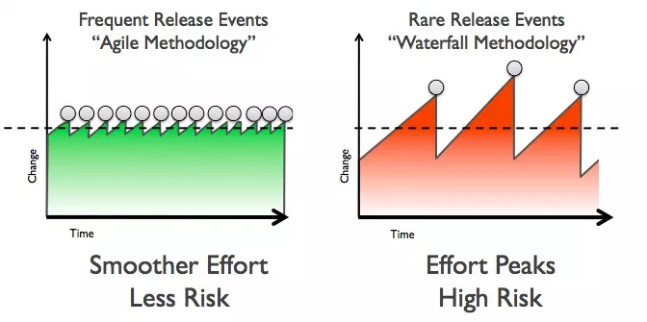
DELIVER WORKING SOFTWARE FREQUENTLY
Delivering frequently provides immediate value to the customer
It is the role of the team to make sure each feature is fully developed, tested and accepted by the product owner before stating it as delivered
The project team activities are structured within a sprint to focus on delivery of value
So, focus more on delivering rather than just planning for delivery. This gives you the opportunity to improve the efficiency and effectiveness of the work

Slide 37
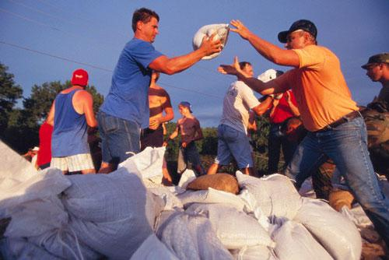
WORKING TOGETHER
This one is crucial, especially because it doesn’t come naturally to most people
Co-location between business people and developers is usually the best way to handle this
Use communication tools for remote workers
Communication helps the two sides better understand each other and leads to more productive work

Slide 38
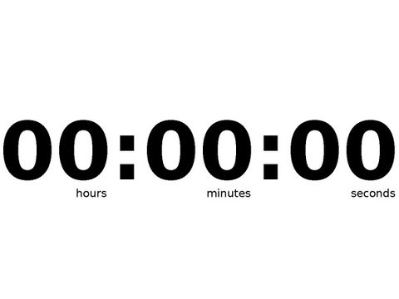
Multi-tasking
Take a blank piece of paper and draw three columns.
Below is a series of numbers of numbers letters and roman numerals
Your job is to copy out the numbers, letters and roman numerals in the following pattern..
Example: A 1 I
B 2 …..
Time yourself against the clock
Numbers | Letters | Roman Numerals
1, 2, 3, 4, 5, 6, 7, 8, 9, 10 | A, b, c, d, e, f, g, h, i, j | I, II, III, IV, V, VI, VII, VIII, IX, X
Notes:
Alice
Is everyone ready? Any questions? Ok…. let’s go! Press play on video clock
https://www.agileconnection.com/article/multitasking-evil

Slide 39
Multi-tasking
Turn your piece of paper over and create 3 columns again
Copy down the same numbers, letters and roman numerals but this time do each set sequentially
Example: A
B
C
Time yourself against the clock again.
Numbers | Letters | Roman Numerals
1, 2, 3, 4, 5, 6, 7, 8, 9, 10 | A, b, c, d, e, f, g, h, i, j | I, II, III, IV, V, VI, VII, VIII, IX, X
Notes:
Alice
To end the game you can share the following: One of the key reasons why the agile approaches work is that they allow people and teams to "single task." That is, agile forces us to focus on doing just one smallish thing at a time. Iterations limit the amount of features a team can start, and most teams quickly discover that it is far easier to have each person working on one task at a time. Well-run maintenance teams tend to work on just a few small tasks at one time. Working in small batches is the key innovation of lean manufacturing and lean and kanban software teams. It's a lot easier to get one smallish thing right at a time than it is to get one large thing right or many small things right.
https://www.agileconnection.com/article/multitasking-evil

Slide 40
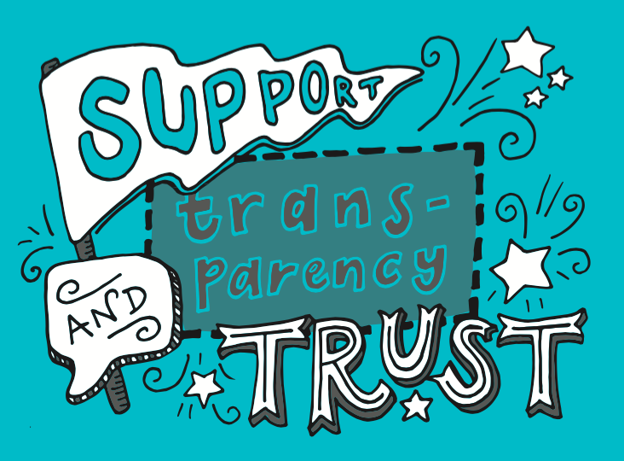
TRUST AND SUPPORT
Products are built by motivated individuals who are given the environment and support they need
Individuals are trusted to get the job done
Team members choose the jobs they are most interested in through self organisation and NOT through external management influence
Micromanagement and top-down approaches to management are not accepted

Slide 41

WORKING SOFTWARE
This is the primary metric an agile development team should be judged by:
Is the software working correctly?
OR
Is the project achieving what we want it to?
Because if it’s not, it doesn’t matter how many words have been typed, bugs have been fixed, hours have been worked, etc.
A good team needs to produce quality products all other measures are pretty much irrelevant if you can’t get it working correctly

Slide 42
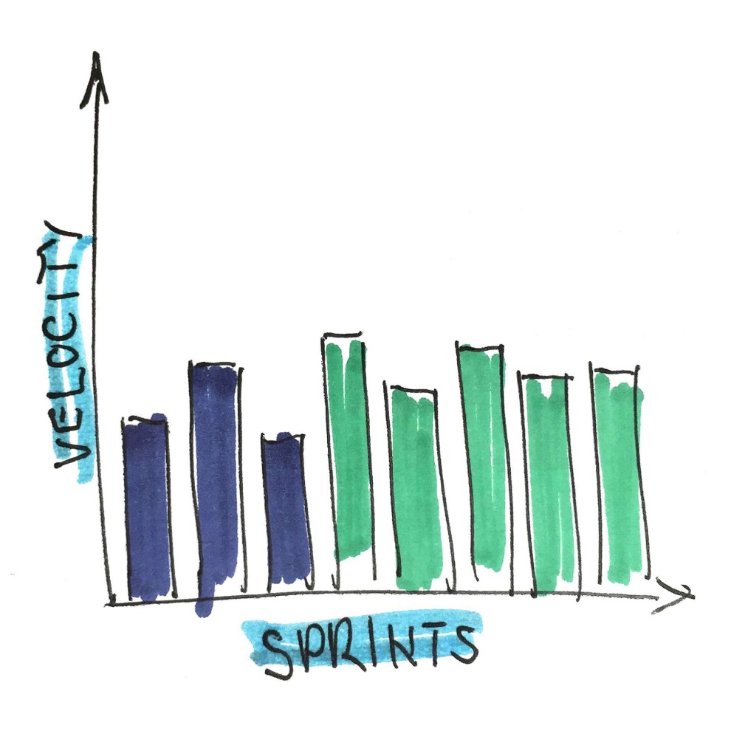
SUSTAINABLE DEVELOPMENT
When working on the same project for a long time, burnout can be a common problem among agile teams.
To prevent this, work should be done in short productive bursts because excessive overtime cannot continue indefinitely without impacting the quality. Focus on choosing the right pace for the team members
Usually, the best pace is one that allows team members to leave the office tired yet satisfied

Slide 43
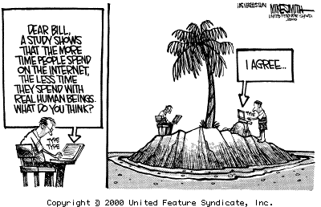
FACE TO FACE COMMUNICATION
Your team should primarily communicate orally for the benefit of osmotic communication
Virtual team conversations should be facilitated via video conferencing where necessary
When obtaining feedback, be sure to go to the source of the problem or confusion to ask for their views
Communication over email should be reduced

Slide 44
Requirements Game
Notes:
Alice & Kevin
Prep work: On two separate flipcharts, draw a few variably complex abstract pictures (I do three or four pictures each), and assign them some value points that roughly align with their complexity. Normally I make these points add up to a total of 100 on each sheet, just for simplicity.
Round One:
Split the class into Customer teams and Delivery teams (I typically do this by table).
Place one flipchart so that only the Customer teams can see it.
Give the Customers 8 minutes to describe the pictures using written words alone, which they must place on Sticky notes and then give to the instructor to run over to their Delivery teams.
Debrief: How did that feel?
Round Two:
Every student that was on a Delivery team is now a Customer, and vice versa.
Have the Customers bring their phones and take pictures of the other flipchart.
Have Customers pair up with Developers once they have the pictures in hand, and stand over their shoulders.
Give the Customers 8 minutes to describe the pictures verbally, while their Developers draw.
Debrief is largely around the following points:
Tight, direct feedback loops are critical to joint understanding
Wordsmithing stories is much less important than communicating the right way with the right people while building and describing them
Documentation should generally follow clarifying discussions, not precede and lead them, because the latter case
Methods like this should inform how you set up things like grooming sessions

Slide 45
Requirements Game
Round 1
Divide into pairs.
One of you is the analyst, the other is the drawer.
Each of the analysts will be given an abstract picture. DO NOT SHOW YOUR PICTURE TO YOUR DRAWER!
You have 5 minutes to draw the picture. The analyst only allowed to write down requirements and then must pass them to the drawer. They are not allowed to talk to their drawers.

Slide 46
Requirements Game
Round 2
Remain in your same pairs.
Each of the analysts will be given a new picture. DO NOT SHOW YOUR PICTURE TO YOUR DRAWER!
You have 5 minutes to draw the picture. But this time, the analyst is allowed to explain to the drawer how the picture should look and is allowed to answer any clarification questions.

Slide 47
Requirements Game
What did we learn?
What ground rules should we set as a team around communication?
What role should written communication (emails & hangouts), documentation and face to face/phone play in our team discussions?
Notes:
Alice , Kevin , Grace - ask questions, prompt with real life examples
Debrief is largely around the following points
Tight, direct feedback loops are critical to joint understanding
Wordsmithing stories is much less important than communicating the right way with the right people while building and describing them
Documentation should generally follow clarifying discussions, not precede and lead them, because the latter case
Methods like this should inform how you set up things like engineering discussion sessions

Slide 48

MAINTAIN SIMPLICITY
Keep things simple and minimise time between comprehension and completion.
Avoid doing things that don’t matter
Keep focused on what is essential to create value not on distractors
Apply the 80/20 rule. This means typically 80% of your results may come from 20% of your efforts. The idea is to focus on the important 20% of effort that gets the majority of the results

Slide 49
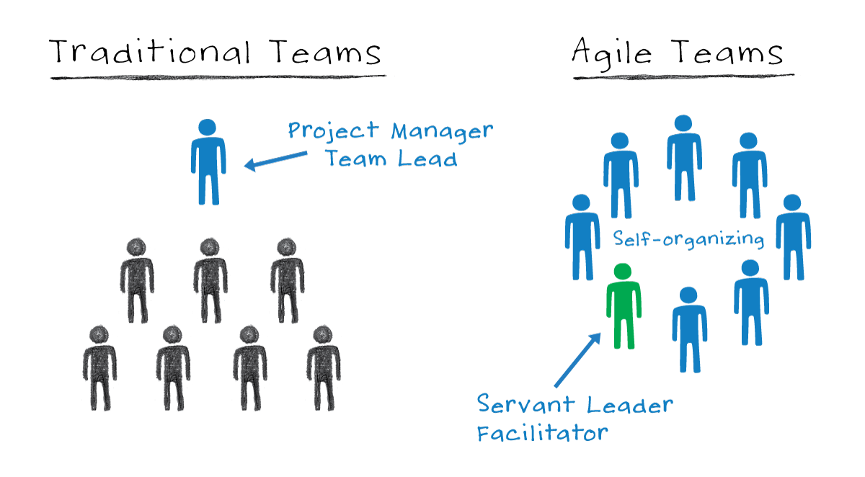
SELF-ORGANISING TEAMS
An agile team should not need to be told what needs to be done.
They tackle problems, clear obstacles and find solutions.
The team have the autonomy and responsibility to meet the goals of the sprint and are responsible for deciding how work will be completed.
Put simply, the team knows best how to carry out the work not the project manager

Slide 50
Self-organising teams
Tightly Managed Teams | Self Organising Teams
Take directions | Take initiative
Seek individual reward | Focus on team contributions
Focus on low-level objectives | Concentrate on solutions
Compete | Co-operate
Stop at pre-set goals | Continuously improve
React to emergencies | Take steps to prevent emergencies

Slide 51
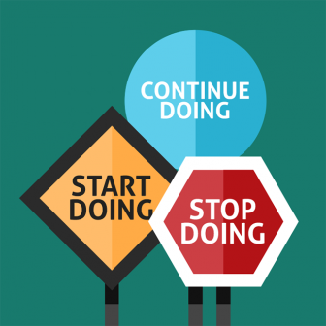
REFLECT AND ADJUST
Just because you’ve done things a certain way for a long time does not mean it is still the best way to do things
At regular intervals the team reflects on how to become more effective, then adjust its behaviour accordingly
Retrospectives enable teams to learn, capture and apply lessons throughout the project lifecycle.
This enables continuous improvement

Slide 52
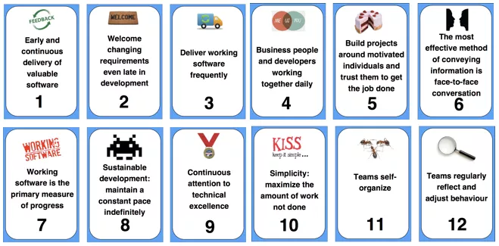
Agile Principles
Notes:
Alice
The core Agile Manifesto values are captured in twelve principles:
Customer satisfaction through early and continuous software delivery - Customers are happier when they receive working software at regular intervals, rather than waiting extended periods of time between releases.
Accommodate changing requirements throughout the development process - The ability to avoid delays when a requirement or feature request changes.
Frequent delivery of working software - Scrum accommodates this principle since the team operates in software sprints or iterations that ensure regular delivery of working software.
Collaboration between the business stakeholders and developers throughout the project - Better decisions are made when the business and technical team are aligned.
Support, trust, and motivate the people involved - Motivated teams are more likely to deliver their best work than unhappy teams.
Enable face-to-face interactions - Communication is more successful when development teams are co-located.
Working software is the primary measure of progress - Delivering functional software to the customer is the ultimate factor that measures progress.
Agile processes to support a consistent development pace - Teams establish a repeatable and maintainable speed at which they can deliver working software, and they repeat it with each release.
Attention to technical detail and design enhances agility - The right skills and good design ensures the team can maintain the pace, constantly improve the product, and sustain change.
Simplicity - Develop just enough to get the job done for right now.
Self-organizing teams encourage great architectures, requirements, and designs - Skilled and motivated team members who have decision-making power, take ownership, communicate regularly with other team members, and share ideas that deliver quality products.
Regular reflections on how to become more effective - Self-improvement, process improvement, advancing skills, and techniques help team members work more efficiently.

Slide 53
Scrum

Slide 54
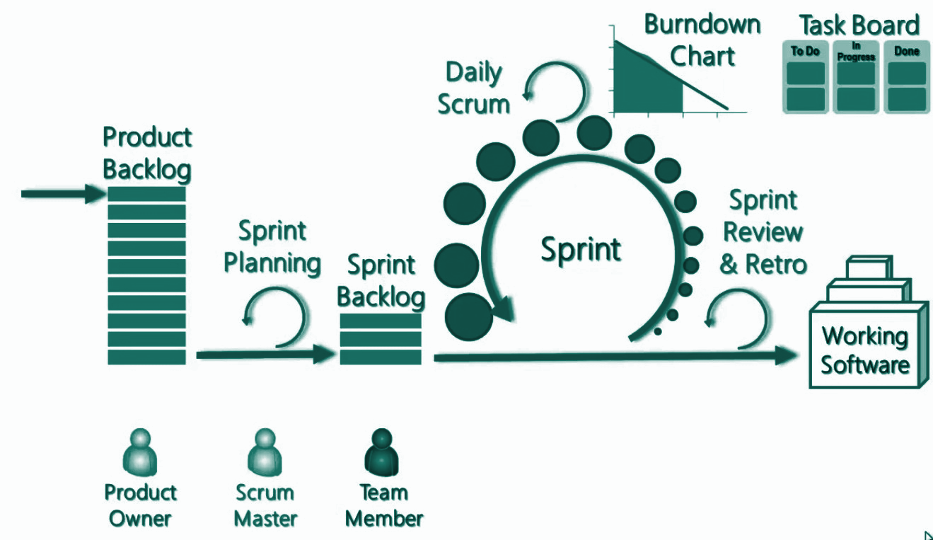
Sprint Cycle
Notes:
A Sprint, a time-box of one month or less during which a “Done”, useable, and potentially releasable product Increment is created.
Sprints have consistent durations throughout a development effort.
A new Sprint starts immediately after the conclusion of the previous Sprint.
During the Sprint:
No changes are made that would endanger the Sprint Goal;
Quality goals do not decrease; and,
Scope may be clarified and re-negotiated between the Product Owner and Development Team as more is learned.

Slide 55
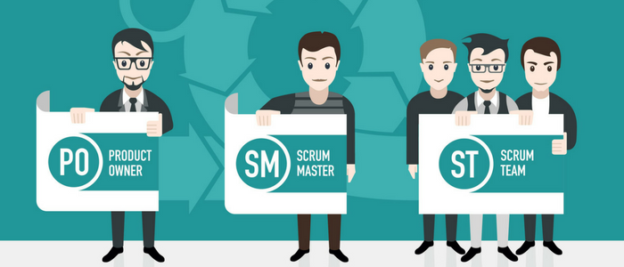
Scrum Roles

Slide 56
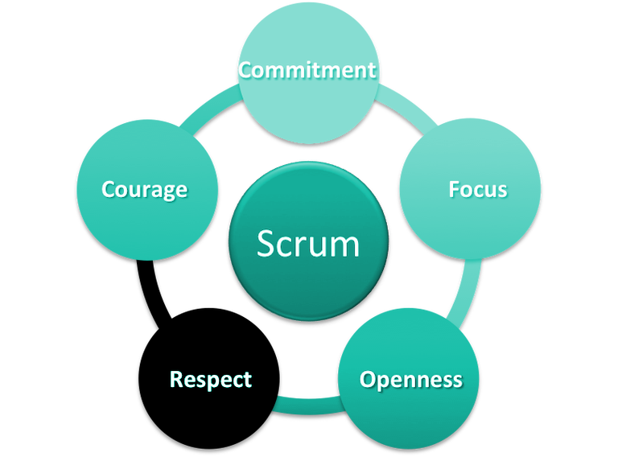
Scrum Values
Notes:
Sameer:
How do we facilitate this slide? Maybe ask the audience for one example of each value as demonstrated by our team? e.g. there was a time when we showed focus by working on x and y

Slide 57

Scrum Master
Notes:
Run to 4 mins : Video - https://www.youtube.com/watch?v=oheekef7oJk&t=104s
How can we facilitate role of scrum master?

Slide 58

Scrum Master
FACILITATOR / REMOVE BARRIERS
PROTECT TEAM FROM EXTERNAL INTERFERENCE
ENFORCE SCRUM PRINCIPLES
IMPROVE PRODUCTIVITY
ENABLES COLLABORATION

Slide 59
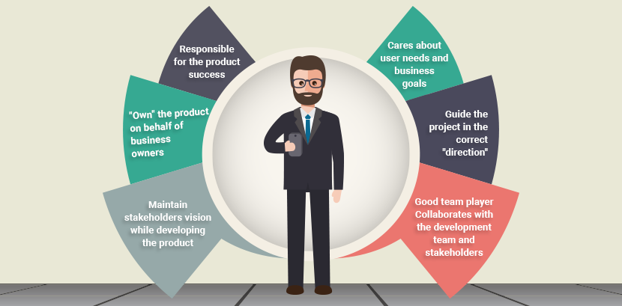
Product Owner

Slide 60
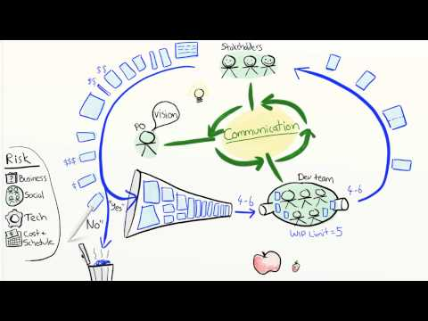
Product Owner
Notes:
Run to 5 mins 40 seconds.
RuVideo - https://www.youtube.com/watch?v=502ILHjX9EE

Slide 61

Development Team
Cross Functional
Skilled for requirements
Creates Demoable components
Includes Devs, QAs & designers
Self Organising
Co-located
Empowered & Autonomous

Slide 62
Activity: Scrum Roles
Divide into two teams
Place the tasks against the scrum role you think does this activity
Discuss with others why you put which cards on which table
Open Discussion
What happens to the classical project management responsibilities in Scrum?
Do we need a project manager as well?
Questions?
Roles with multiple hats?
Notes:
Split into two groups - two facilitators per group
Print out answers for facilitators to refer to
5 minutes categorisation
5 minutes - wrong / right and then discuss why?
http://tastycupcakes.org/2014/01/scrum-roles-and-responsibilities-game/

Slide 63
Scrum Cycle

Slide 64
Scrum Ceremonies
Notes:
Kevin to present

Slide 65
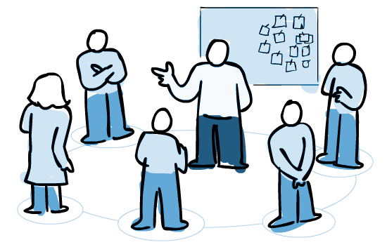
Daily Scrum
Keep in mind:
Same Place, Same Time
Stand-up to keep it focused
Focus on the backlog – but don’t be too task oriented
Keep a Blockage list and use it to Start the Day
Huddle so that everyone can hear
Signal the end with a comment to keep energy up
Late arrivals speak first
Rotate facilitator
Many faces of Jack Sparrow
Speak about:
What did I do yesterday?
What am I doing today?
What are my blockers?
Do I need help?
Notes:
Objective
To set the context for the coming days work
Participants
Scrum master, product owner, Software and QA engineers
When
In the morning
Duration
Time-boxed to 15 minutes
Inputs
What you did yesterday
What you will do today
ANy impediments in your way
Tips

Slide 66
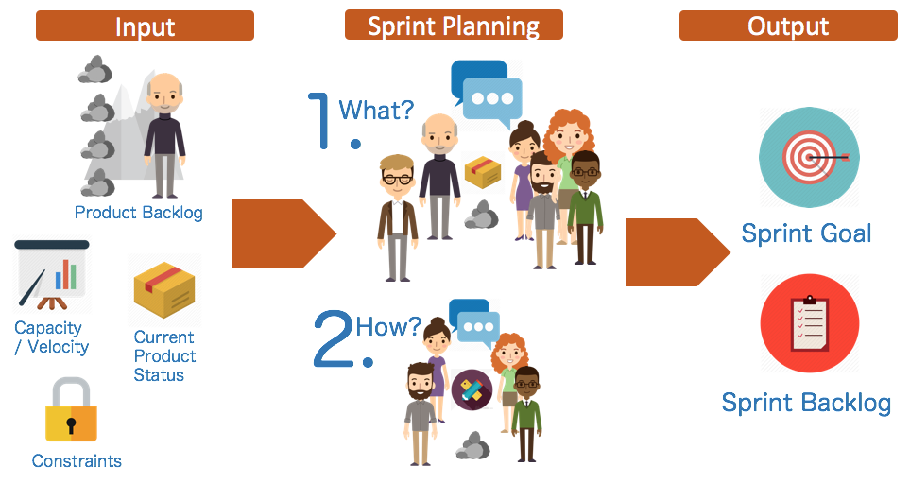
Sprint Planning
Notes:
Participants
Scrum master, product owner, entire scrum team
When
At the beginning of a sprint
Duration
Roughly 1hr
Inputs
Product owner describes highest priority features to the team
The product owner sets the goal and the team commits to what they think they can achieve in the upcoming sprint.
Start of sprint
Whole team should be available
Goals set from a prioritised, refined backlog
Stories are estimated
Team capacity is understood
Team commits stories

Slide 67

Backlog Refinement
I’m glad we all agree
?
Notes:
To ensure that the backlog is refined and team can pick up stories ready for future sprints. The team should spend around 10% of each current sprint refining for future sprints.
Whole team, no set cadence
Product owner should come with a prioritised backlog to discuss
Are the priorities for the next sprint(s) clear?
Are the scrum team clear on exactly what the stories involve?
Are the stories at the top of the backlog ‘Ready for Sprint’ e.g. acceptance defined, tests written

Slide 68
Sprint Review
The scrum team demo their work to the product owner and stakeholders who review, test and feedback on the work that has been done in the sprint. Sprint results to be demo’d may include non-software outputs
The review should be a chance for the team to celebrate their accomplishments as well as review their results. During the review the team should look at burndown charts and sprint velocity.
The review provides another opportunity for feedback, allowing the team to fold in changes in priority or requirements into the next Sprint. However, feedback shouldn't overturn accepted / rejected story status.

Slide 69
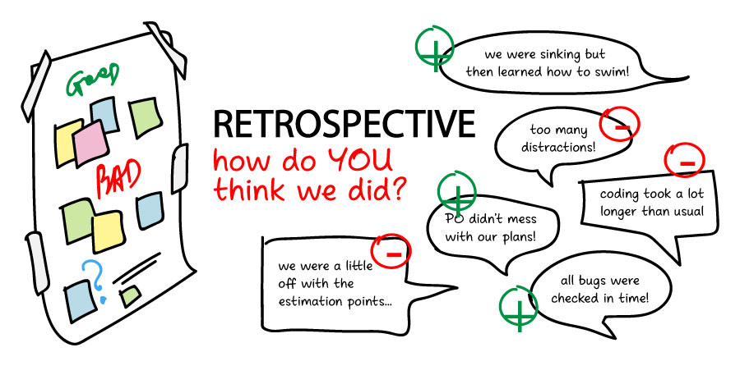
Sprint Retrospective
Notes:
The whole team reflect on what has gone well and what can be improved for next sprint
End of sprint
Objective, reflective, interpretive, decisional
Whole team
Review previous retro actions
Post-its for thoughts, theme and vote
Create action plan
Temperature checks
Mix it up each sprint!

Slide 70
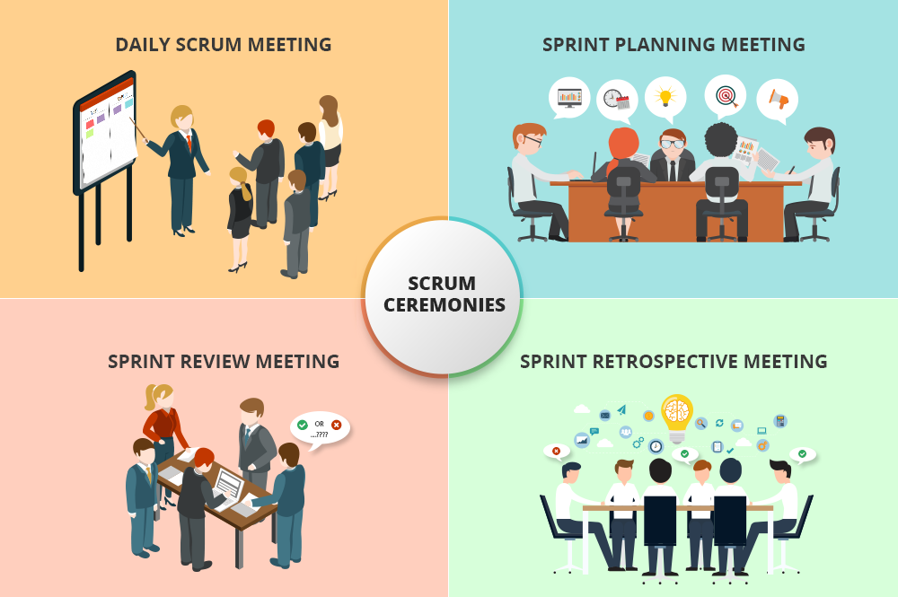
Scrum Ceremonies
Facilitate team communication
BACKLOG REFINEMENT

Slide 71
Sprint and Velocity
Sprint
1
2
1
1
2
1
2
The Stories
with Story Points
2
2
1
1
2
4
1
1
2
1
1
2
4
4
Notes:
A sprint is a bucket of fixed size
Sprint planning fits stories into the sprint.

Slide 72
Planned Velocity
Planned
Velocity
Actual
Velocity
Next Planned
Velocity
1
1
2
1
1
2
2
2
2
2
= 16
= 12
= 12
1
1
2
1
1
2
4
4
4
4
Notes:
How do you know how big the sprint bucket is?
Initial capacity of ‘Agile Bucket’ = planned velocity - how much the team think they can deliver
However actual velocity is used for future sprints - this ensures the sprint plan is accurate as it is based on previous velocity not optimistic estimation

Slide 73
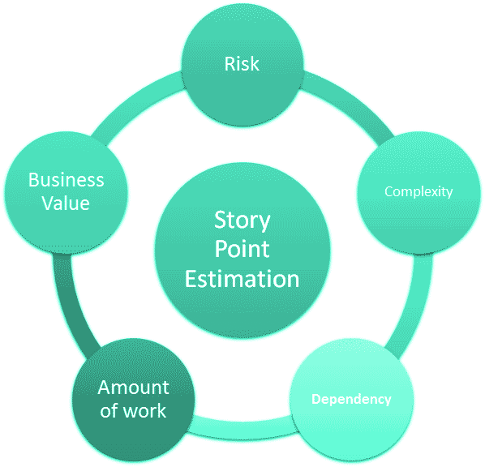
Estimation
An estimate is our best guess for what can be achieved and by when.
Estimation is done in points.
It’s a team sport
Team should agree on upper limit
Gives PO insight to help prioritise
Learn from past estimates
Estimation is a practice - you'll get better and better with time
Use Triangulation
Notes:
By estimating we can know how long a story will take to be developed. The technique used to determine how long is called planning poker.
Estimation is hard. For software developers, it's among the most difficult–if not the most difficult–aspects of the job. It must take into account a slew of factors that help product owners make decisions that affect the entire team–and the business and fixes
Before estimating the product managers should have sorted out the list of work to be done. Each task contains a short description of all the desired features and fixes. When the estimation process begins questions about the requirements arises which helps in the following ways:
The team is able to understand the work load fully
Missing requirements or assets like mocks if needed can be identified

Slide 74
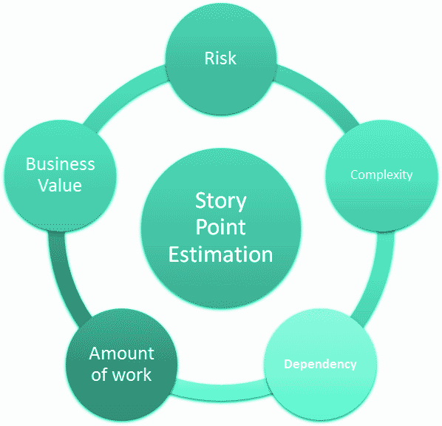
Estimation Techniques
Planning Poker
T-Shirt Sizes
Dot Voting
Large/Uncertain/Small
Affinity Mapping
Notes:
By estimating we can know how long a story will take to be developed. The technique used to determine how long is called planning poker.
Estimation is hard. For software developers, it's among the most difficult–if not the most difficult–aspects of the job. It must take into account a slew of factors that help product owners make decisions that affect the entire team–and the business and fixes
Before estimating the product managers should have sorted out the list of work to be done. Each task contains a short description of all the desired features and fixes. When the estimation process begins questions about the requirements arises which helps in the following ways:
The team is able to understand the work load fully
Missing requirements or assets like mocks if needed can be identified

Slide 75

Planning Poker Technique
Steps
Each estimator is given a set of cards containing only the numbers that are going to be used (we use the sequential sequence)
Product owner reads a user story and its discussed briefly
Each estimator selects a card that is his or her estimate
Discuss differences (Especially Outliers)
Re-estimate until estimates converge
Notes:
How are we doing estimation? Are we doing it well? Could we be doing it differently?

Slide 76
Scrum Artefacts

Slide 77
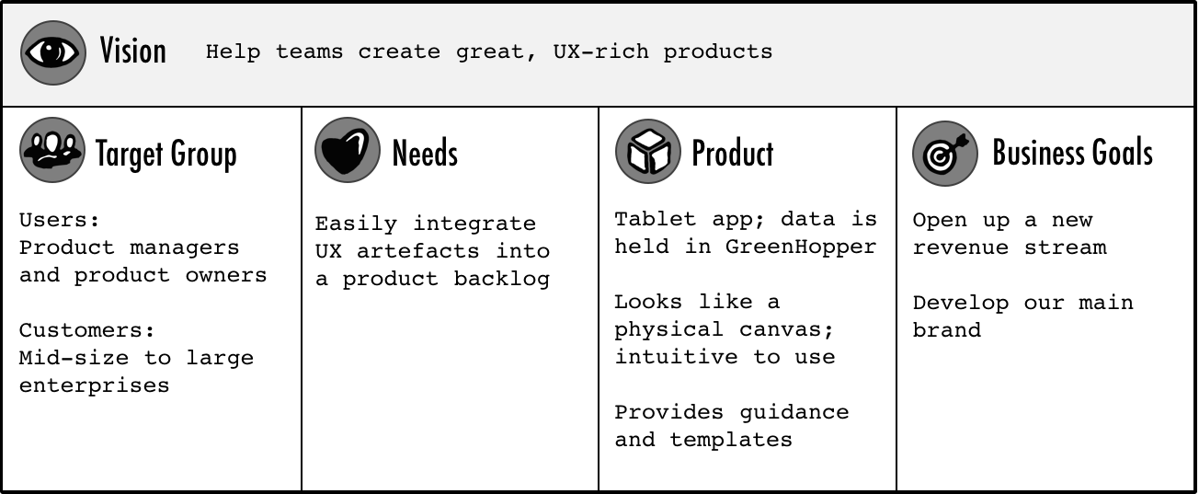
Product Vision
“The product vision is the overarching goal you are aiming for, the reason for creating the product. It provides a continued purpose in an ever-changing world, acts as the product's true north, provides motivation when the going gets tough, and facilitates effective collaboration” Roman Pilcher
Notes:
Alice

Slide 78
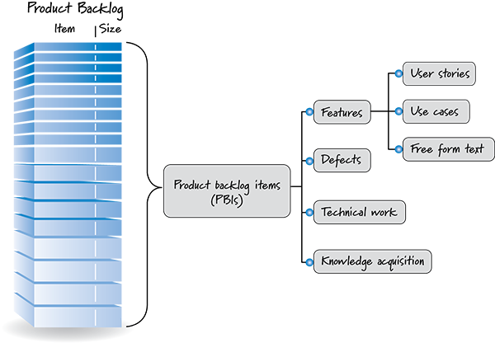
Product Backlog
The agile product backlog in Scrum is an ordered and emerging list of user needs plus anything else that is required to fulfil the product vision. It’s is ever-evolving and never baselined, ‘signed-off’ or static.

Slide 79
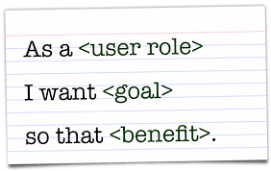
USER STORIES
A good user story is…
Independent (of all other)
Negotiable (not a fixed solution)
Valuable (a vertical slice)
Estimatable (to an approximation)
Small (enough to fit into a sprint)
Testable (once completed)

Slide 80
Definition of Done
The team will agree a standard definition of done which applies to every story in the backlog
If a story has not achieved the definition of done, it must be returned to the product backlog and not be completed as part of this sprint
The definition of done provides a common understanding to the entire team of what is needed in order for the stories to be completed
DoD
All acceptance criteria have been met
Code has been peer reviewed
UI guidelines followed
All tests have passed
Reviewed and signed off by product owner
Notes:
The team will agree a standard definition of done which applies to every story in the backlog
If a story has not achieved the definition of done, it must be returned to the product backlog and not be completed as part of this sprint
The definition of done provides a common understanding to the entire team of what is needed in order for the stories to be completed
E.g. All acceptance criteria have been met
Code has been peer reviewed
UI guidelines followed
All tests have passed
Reviewed and signed off by product owner

Slide 81
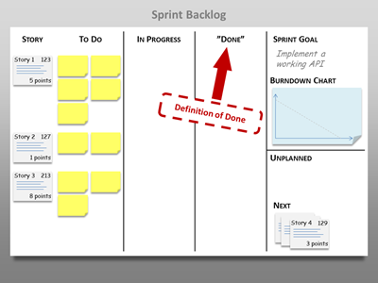
Sprint Backlog
A list of stories which the scrum team have identified need to be completed as part of a sprint in order to achieve the sprint goal.
Sprint backlog basics
Contains all tasks and stories that have been committed to a sprint by the scrum team which align to the sprint goal
All stories are estimated and allocated to the team
Team update progress throughout the sprint

Slide 82
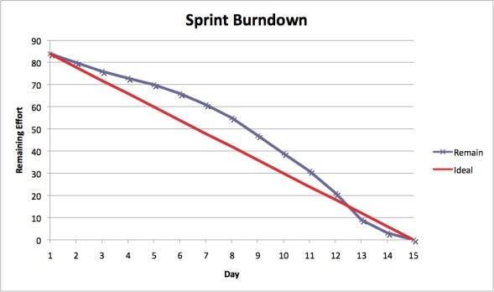
Sprint Burndown Charts
A chart illustrating the comparison between the initial estimated amount of work (what was committed during the sprint) and the work left to do
It should be used by the team to manage themselves during the sprint
The scrum master is responsible for ensuring that the team is aware of the burndown status and encourage team to update the chart

Slide 83
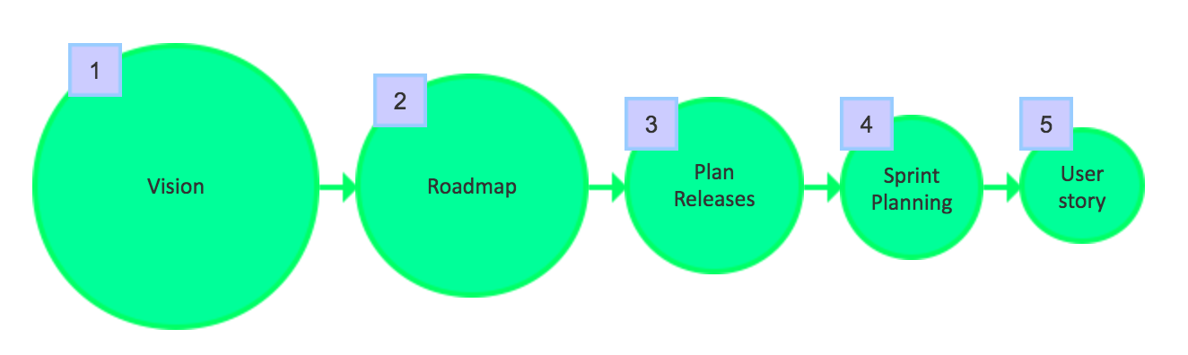
Agile Planning
Notes:
There are five levels of Agile Planning
We have already talked a product vision, sprint planning and user stories.
In this section we will talk about roadmaps and release planning.

Slide 84
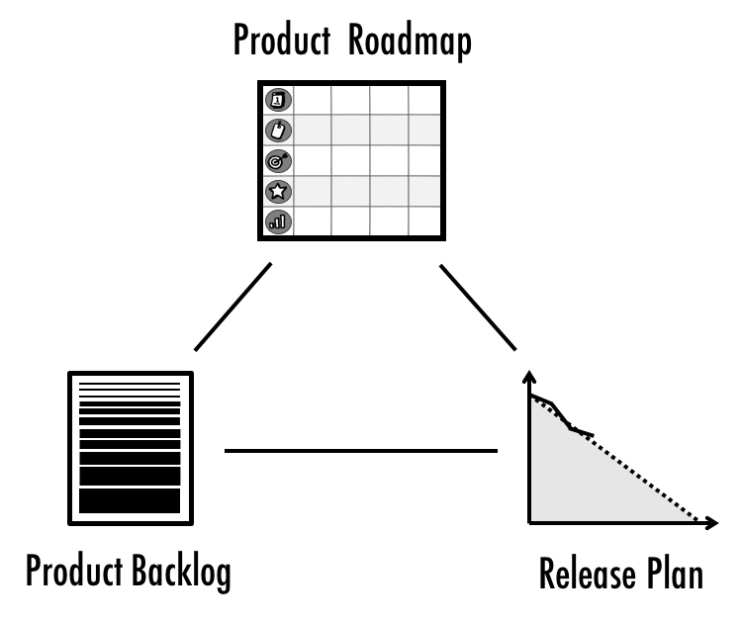
Roadmap, Product Backlog & Release plan
The product roadmap is the high level plan for the entire product.
The release plan covers one step in the product roadmap.
The release plan is informed by both the product roadmap and product backlog
Notes:
A product roadmap communicates how a product is likely to evolve across several major releases. Unlike the release plan, it is a product plan that looks beyond an individual project or release: It describes the journey you want to take your product on over the next 12 months or so—much like a roadmap helps you plan a road trip.
Product Backlog is simply a list of all things that needs to be done within the project. It replaces the traditional requirements specification artifacts. These items can have a technical nature or can be user-centric e.g. in the form of user stories.
A release plan forecasts how a major release is developed. It’s a type of project plan—albeit an agile one—and it usually covers the next three to six months.

Slide 85
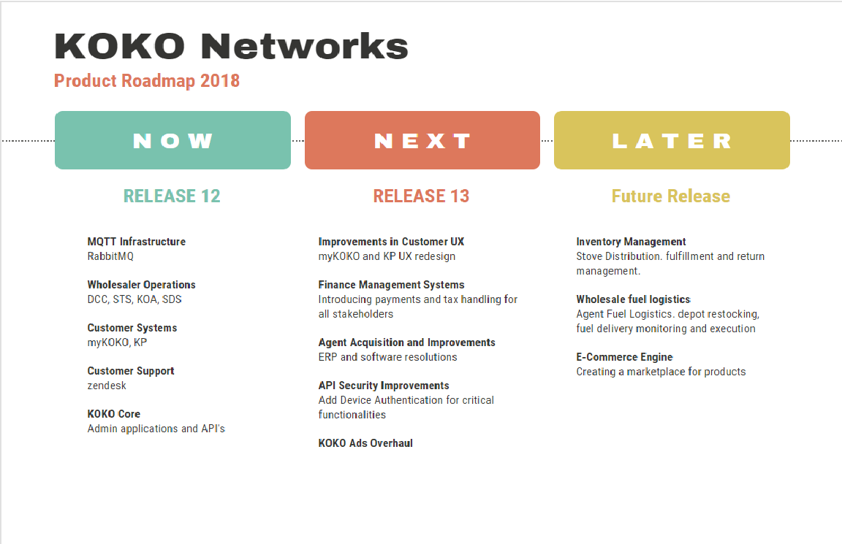
Our roadmap
Notes:
Roadmaps contain:
A strategy statement
A timeline of various initiatives and project
A prioritized list of improvements and opportunities
High level justification for each project
The estimated cost and duration of each project
An owner of each project

Slide 86
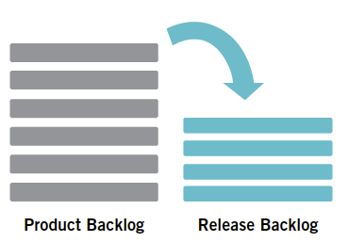
Release Plan
In order to create a release plan, the following things must be available:
A prioritised and estimated product backlog
The estimated velocity of the team
Release goals agreed (plus the team who will be delivering)
Notes:
A release plan is a very high-level plan for multiple sprints and is created during release planning
It is a guideline that reflects when certain features could be implemented.
It can serve as a based to monitor progress.
The release plan can be linked to the roadmap, but provides another level of detail

Slide 87
Agile Articulate
Notes:
Need to write out rules

Slide 88
Wrap up
Everybody answer each of the three questions:
What was the best bit about today’s training?
What could have been better?
What did you learn from today that might improve our current ways of working as a result of today’s training?
Notes:
Grace capturing answers

